Slide 1

DEPARTMENT OF COMPUTER SCIENCE

Slide 2
COURSE OUTLINE
Course Title | COSC3081
Degree Program | Data Communication and Computer Networking
Course Code | BSc. In Computer Science
Credits/Contacts | 3/4
Prerequisite | COSC 2042
Semester | 1st Semester / Year III
Status of Course | Compulsory
Course Objectives and Competences to be acquired | After a successful completion of this course, students will be able to: Explain the basic concepts of data communication; Characterize digital and analog signal transmission;

Slide 3
COURSE OUTLINE--------
Course Objectives and Competences to be acquired | Differentiate serial and parallel signal transmission modes; Compare and contrast different multiplexing techniques; Explain different error detection and correction methods; Describes types and applications of computer network; Name and compare different types of data transmission media; Explain layers of OSI model and TCP/IP protocol suite;

Slide 4
COURSE OUTLINE--------
Course Objectives and Competences to be acquired | Discuss IP addressing schemes and Sub-netting; Name and compare LAN connectivity devices; Describe wireless LAN technologies (IEEE 802.11); Describe WAN technologies: Routers, Layer 3 Switches; Discuss routing protocols (RIP, EIGRP,OSPF); WAN Technology Options and Build small to medium level Computer networks

Slide 5
COURSE OUTLINE--------
Course Description | This course is designed to acquaint students with the various types of data communication systems and computer networks. Particular emphasis will be given to the following topics: Data Communication Basics, Computer network types and their applications, Data Communication and Transmission Medias, Layered architectures (OSI & TCP/IP), LAN connectivity devices, “IP addressing and sub-netting” and WAN Technologies. The student will gain hands-on experience in the Lab session with building small to medium level LANs including Cabling, Configuring TCP/IP, Peer to Peer Networking, Sharing resources, Client Server Networking, Protocol analysis, and Administration.

Slide 6
 | Course Content
 | UNIT ONE: DATA COMMUNICATION BASICS 1.1 What is Data Communication 1.2 Data Representation techniques 1.3 Data communication model and standards (EAI/TIA, IEEE, ISO, ANSI) 1.4 Modes of data transmission (simplex, half-duplex, full-duplex) 1.5 Signal transmission and error detection and correction 1.5.1 Transmission of analog and digital signals 1.5.2 Transmission Impairments (attenuation, distortion, noise) 1.5.3 Serial and parallel data transmission modes 1.5.4 Multiplexing techniques (FDM, TDM, …) 1.5.5 Error detection and correction

Slide 7
 | Course Content---------
 | UNIT TWO: NETWORK TRANSMISSION MEDIA 2.1 Twisted-pair cables (UTP, STP) 2.2 Coaxial cables (10 Base 2, 10 Base 5) 2.3 Fiber Optics cables (single mode, multi-mode) 2.4 Wireless media (wireless LAN, IR, Microwave and Satellite) UNIT THREE: FUNDAMENTALS OF COMPUTER NETWORKS 3.1 Computer network and its benefits 3.2 Difference between LAN and WAN 3.3 Network types: Sever-based networks and peer-to-peer networks 3.4 LAN topologies(star, bus, ring, mesh, hybrid)

Slide 8
 | Course Content---------
 | UNIT FOUR: OSI AND TCP/IP NETWORK MODELS 4.1 The Need for Layer Architecture 4.2 The Seven Layers of an OSI Model 4.3 Data encapsulation 4.4 Physical Layer and its responsibilities 4.5 Data-link layer and its responsibilities: Error Detection and Correction, Data Link Control, Data Link layer Protocols 4.6 Network layer and its services 4.6.1 Logical addressing (IPv4, IPv6) 4.6.2 Address mapping (ARP, RARP, BOOTP, DHCP) 4.6.3 Error reporting and multicasting (ICMP, IGMP)

Slide 9
 | Course Content---------
 | 4.6.4 Delivery, Forwarding, Routing(unicast routing protocols, multicast routing protocols) 4.7 Transport Layer and its services 4.7.1 Multiplexing and Demultiplexing 4.7.2 Connectionless Transport: UDP 4.7.3 Reliable Data Transfer: TCP 4.7.4 Congestion Control and Quality of service 4.8 Application layer and its services 4.9 Compare TCP/IP suite with OSI reference model 4.10 Layers of TCP/TP protocol suite

Slide 10
 | Course Content---------
 | UNIT FIVE: WAN AND LAN TECHNOLOGIES 5.1 Local Area Network s(LANs) and connectivity devices 5.1.1 Ethernet LANs (standard, fast, Gigabit Ethernet) 5.1.2 LAN connectivity devices (Repeater, switch, bridge, router, ) 5.1.3 Wireless LAN technologies (IEEE 802.11 standards, ad-hoc, BSS, EBSS) 5.2 Wide Area network (WAN) Technologies 5.2.1 WAN Devices: Routers, Layer 3 Switches and Gateways 5.2.2 Routing protocols (RIP, EIGRP, OSPF) 5.2.3 WAN Technology Options

Slide 11
 | Course Content---------
 | UNIT SIX:INTERNET PROTOCOL AND IP ADDRESSING 6.1 IP addressing schemes 6.2 Sub-netting and masking 6.3 TCP/IP utilities (ping, ipconfig, netstat, traceroute, …)

Slide 12
Teaching and learning Methods | Lecture Discussion and case studies Laboratory, Practical work
Assessment/Evaluation and Grading System | Theoretical Tests (30%) Lab test (10%) Project work (10%) Final Exam (50%)
Text Books | 1. Behrouz A. Forouzan; “Data communication and networking”; Tata McGraw-Hill, New York, Fifth Edition, 2013
Reference Materials | 1. Prakash C. Gupta: “Data communications and Networking”; Prentice-Hill Publ. India. 2006 2, William A. Shay: “Understanding data communication and networking”; Thomson Learning

Slide 13
Reference Materials | 3. Todd Lammle: “CISCO Certified network Associate Study Guide"; Wiley Publ. Inc. USA, Seventh Edition, 2011 4. Web site Web site that provides support for students and instructors http://www.mhhe.com/forouzan/dcn4sie 5. Free course materials 5.1 Harvard open learning initiative http://www.extensioin.harvard.edu/open-initiative 5.2 MIT open courseware http://ocw.mit.edu/index.htm 5.3 Yale open courseware http://oyc.yale.edu/ 5.4 Top 10 Universities with free course online http://www.jimmyr.com/blog/

Slide 14
Chapter One
Data Communication Basics
Data Communication and Computer Networks
(COSC 3081)

Slide 15
Communication Basics
Data communications are the exchange of data between two devices via some form of transmission medium such as a wire cable or wireless.
It includes :
  Writing and talking
  Nonverbal communication (such as facial expressions, body language or gestures)
  Visual communication (the use of images or pictures such as painting, photography, video or film)

Slide 16
  Electronic Communication such as,
  telephone calls,
  electronic mail,
  cable television, s
  satellite broadcasts.
For data communications to occur, the communicating devices must be part of a communication system made up of a combination of hardware (physical equipment) and software (programs).

Slide 17
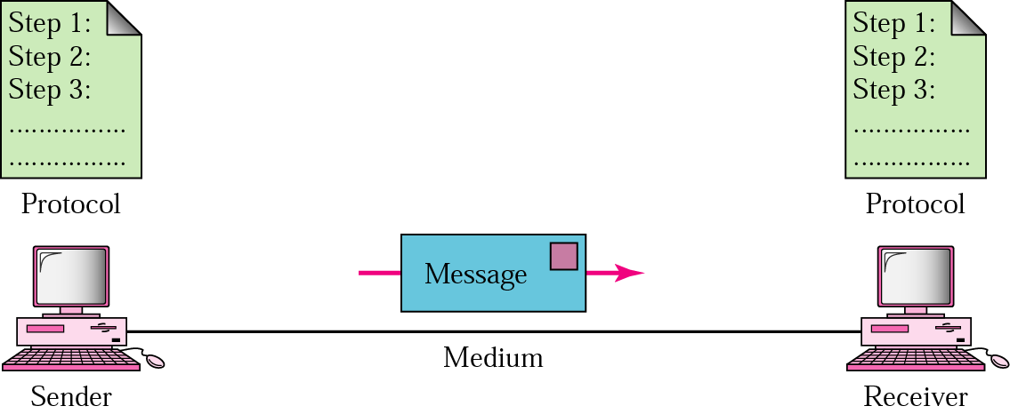
Five components of Data communication
Message
It is the information (data) to be communicated.
Popular forms of information include text, numbers, pictures, audio, and video.

Slide 18
2. Sender
It is the device that sends the data message.
It can be a computer, workstation, telephone handset, video camera, and so on.
3. Receiver
It is the device that receives the message.
It can be a computer, workstation, telephone handset, television, and so on.
4. Transmission medium
It is the physical path by which a message travels from sender to receiver.

Slide 19
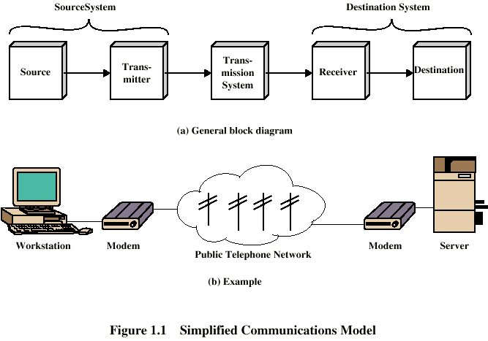
Some examples of transmission media include twisted-pair wire, coaxial cable, fiberoptic cable, and radio waves.
5. Protocol: is a set of rules that govern data communications.
It represents an agreement between the communicating devices.
Without a protocol, two devices may be connected but not communicating, just as a person speaking French cannot be understood by a person who speaks only Japanese.

Slide 20
Serial vs. parallel communications
In serial communications
  A single bit will be transferred at a time using the communication channel.
  Bits will be reassembled at the destination
  Mostly used by computer peripherals like printers,(why do they use such type of communication?)
In parallel communications
  Multiple bits (eg. Eight bits) will be transferred at a time
  Needs multiple (parallel) communication channels

Slide 21
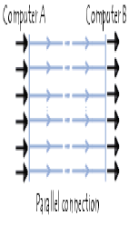
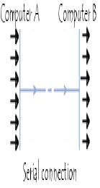
Contd.

Slide 22
Data Representation Techniques
The type of data to be transmitted can be in the form of text, audio, and video in the form of electrical signal, radio, laser, or other radiated energy source.
Data can be analog or digital.
The term analog data refers to information that is continuous;
digital data refers to information that has discrete states.
Example: analog clock (with second, minute and hour hands) and digital clock

Slide 23
Analog and digital signals
Signal: the electrical wave that is used to represent the data.
It can be analog or digital signal
An analog signal has infinitely many levels of intensity over a period of time.
  As the wave moves from value A to value B, it passes through and includes an infinite number of values along its path.
A digital signal, on the other hand, can have only a limited number of defined values.
  Although each value can be any number, it is often as simple as 1 and 0.
Notes:
What does analog and digital really mean?

Slide 24
Analog Vs Digital Signals
Analog Signal | Digital Signal
Signal has infinitely many levels of intensity over a period of time | A signal that can have only a limited number of defined values
Continuous wave that carries information by altering the characteristics of waves | Discrete(on-off) pluses of data transmission that carries covey information in terms of 0s and 1s rather than continues wave
A signal that measures rather than counts | It counts but not measures
Mostly used in Telephone devices | More prevalent in computer based devices
Voice, all sounds, Radio, telephone recording equipment are examples of analog signals | Flashing light and telegraph message are traditional examples of on-off pluses, although not in binary code

Slide 25
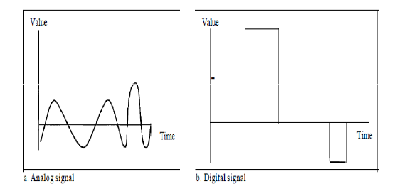
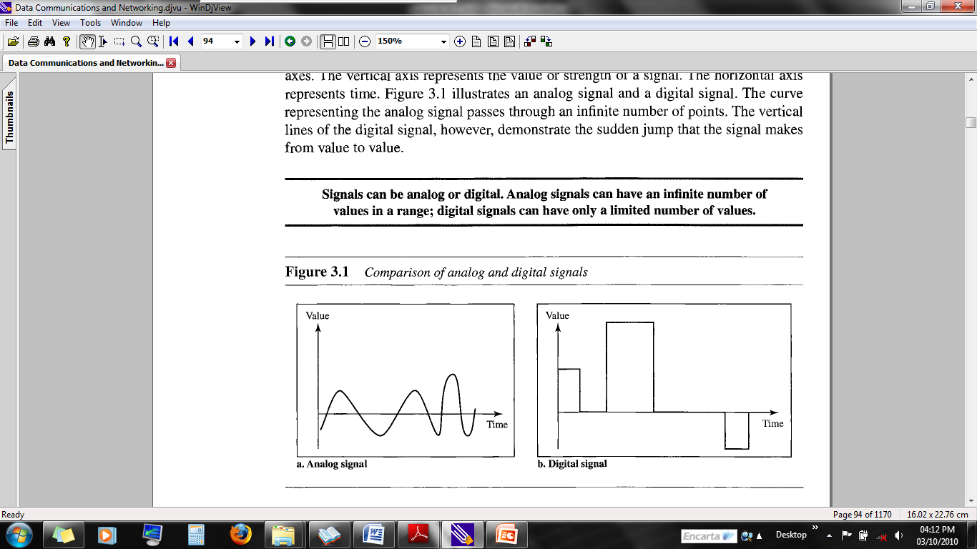
Contd.

Slide 26
Digital Data Transmission Formats
Asynchronous connection:- in which each character is sent at irregular intervals in time
    Starts sending a character using START bit (bit 1 or bit 0)
    Ends Sending a character using STOP bit (bit 1 or bit 0)
    Eg. 1 0100 0001 0
Synchronous connection:- transmitter and receiver are paced by the same clock
Receiver continuously receives(even when no bits are transmitted) the information at the same rate the transmitter send it.
This is why transmitter and receiver are placed at the same speed.
In addition, supplementary information is inserted to guarantee that there are no errors during transmission

Slide 27
Modes of data transmission
There are 3 different transmission modes characterized according to the direction of the exchanges:
A simplex connection is a connection in which the data flows in only one direction, from the transmitter to the receiver.
This type of connection is useful if the data do not need to flow in both directions.
Example,
from computer to the printer or from the mouse to your computer...).
TV transmission

Slide 28
Contd.
A half-duplex connection (sometimes called an alternating connection or semi-duplex) is a connection in which the data flows in both direction or the other, but not at the same time.
With this type of connection, each end of the connection transmits in turn.
This type of connection makes it possible to have bidirectional communications using the full capacity of the line.
In a half-duplex transmission, the entire capacity of a channel is taken over by whichever of the two devices is transmitting at the time.

Slide 29
Contd.
  Walkie-talkies and CB (citizens band) radios are both half-duplex systems.
  The half-duplex mode is used in cases where there is no need for communication in both directions at the same time; the entire capacity of the channel can be utilized for each direction.
  Example:
  Wireless handset (walkie-Talkie)

Slide 30
Full-Duplex: In full-duplex mode (also called duplex), both stations can transmit and receive simultaneously
The full-duplex mode is like a two-way street with traffic flowing in both directions at the same time.
In full-duplex mode, signals going in one direction share the capacity of the link: with signals going in the other direction.
This sharing can occur in two ways:
Either the link must contain two physically separate transmission paths, one for sending and the other for receiving; or the capacity of the channel is divided between signals travelling in both directions.

Slide 31
Contd.
  One common example of full-duplex communication is the telephone network.
  When two people are communicating by a telephone line, both can talk and listen at the same time.
  The full-duplex mode is used when communication in both directions is required all the time.
  The capacity of the channel, however, must be divided between the two directions.
  Example:
  Telephone transmission

Slide 32
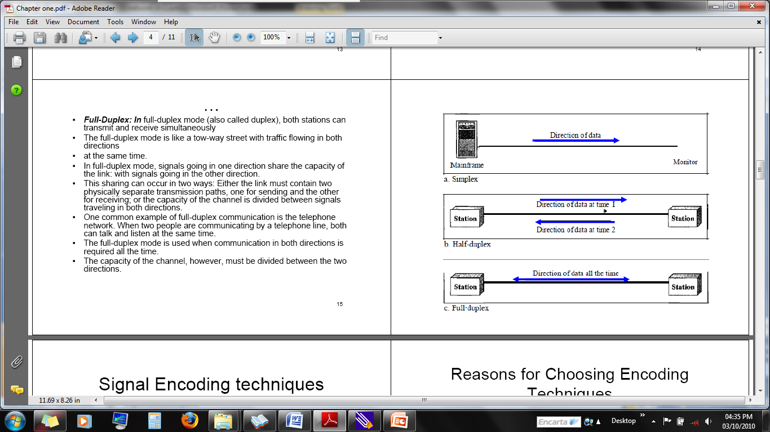
Contd.

Slide 33
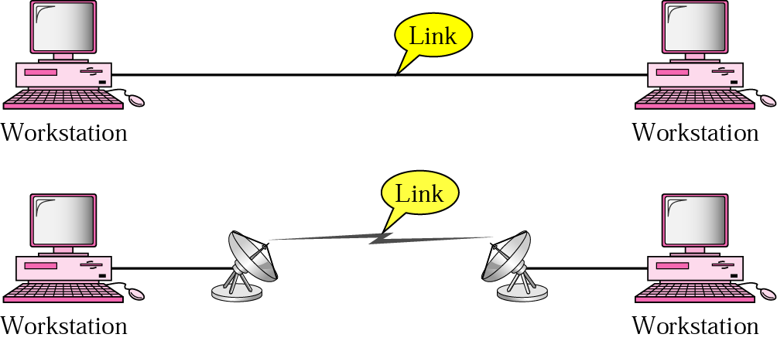
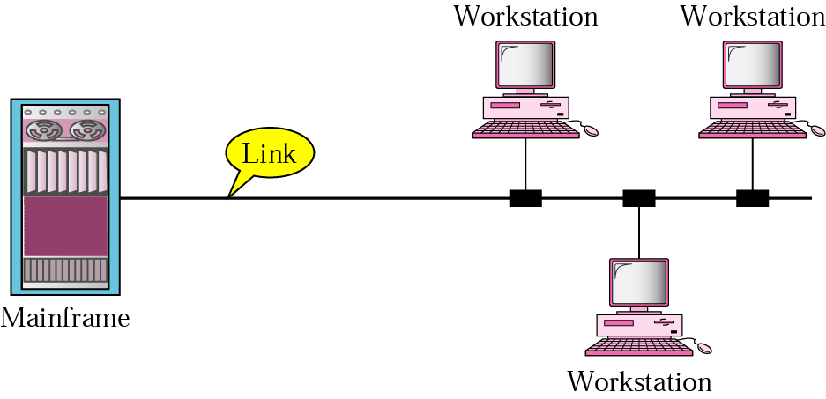
Types of connection
  Point-to-point: provides a dedicated link between two devices
  Multipoint: more than two devices share (spatially -simultaneously - or temporally by taking turns) a single link

Slide 34
Assignment
Describe the following digital signal encoding formats (which format is used by Ethernet?)
  Non return-to-Zero-Level (NRZ-L)
  Non return to Zero Inverted (NRZI)
  Bipolar-AMI
  Pseudoternary
  Manchester
  Differential Manchester

Slide 35
Digital into Analog Encoding Techniques
Modulation involves operation on one or more of the three characteristics of a carrier signal: amplitude, frequency, and phase.
Accordingly, there are three basic encoding or modulation techniques for transforming digital data into analog signals
  Amplitude-shift keying (ASK)
  Frequency-shift keying (FSK)
  Phase-shift keying (PSK)
Read about these techniques

Slide 36
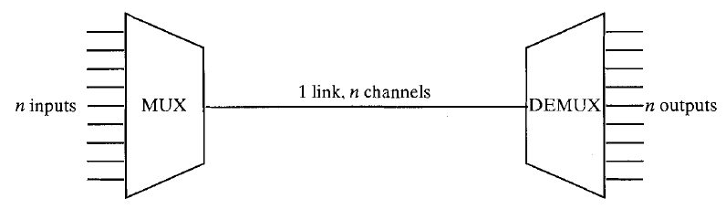
Multiplexing
In data communication, there might be a need to share a single media for multiple communication (media sharing)
Sharing of a single media (fiber, coaxial, microwave,..) is known as multiplexing.
In the above figure, there are n inputs to a multiplexer.
The multiplexer is connected by a single data link to a demultiplexer.
Notes:
Multiplexer-is also known as a data selector, is a device that selects between several analog or digital input signals and forwards the selected input to a single output line

Slide 37
Contd.
The link is able to carry n separate channels of data.
The multiplexer combines (multiplexes) data from the n input lines and transmits over a higher capacity data link.
The demultiplexer accepts the multiplexed data stream, separates (demultiplexes) the data according to channel, and delivers them to the appropriate output lines.

Slide 38
Types of Multiplexing
Frequency-division multiplexing (FDM)
Time-division multiplexing (TDM)
Statistical multiplexing

Slide 39
1. Frequency-division Multiplexing
FDM is a signal transmission technology in which multiple signals can
simultaneously be transmitted over the same line or channel.
FDM can be used in both wired and wireless networking for transmitting large amounts of data at high speeds.
FDM is the simplest and oldest form of multiplexing in wireless networking technology.
Frequency division multiplexing involves simultaneously transmitting multiple signals on different frequencies.

Slide 40
Contd.
These different frequencies, called channels,
share non-overlapping portions of the total frequency band being used.
Signals from different data sources are fed into a multiplexer
that modulates each signal and transmits them at different frequencies.
These signals are then transmitted over the wire or
through wireless communication and are separated at the destination into individual data signals
using a demultiplexer.

Slide 41
2. Time-division multiplexing (TDM)
A multiplexing method for transmitting multiple data streams in a single communication path.
In TDM, the data from different input channels is divided into fixed-length segments and then combined in round-robin fashion into a single output data stream,
which can then be transmitted over a single channel transmission system and demultiplexed at the destination location.
The segments can be created by the multiplexer itself or can be inherent
  in the input channel signals, such as fixed-length frames.

Slide 42
Contd.
For example, if input streams A, B, and C are divided into segments as shown here:
  A: A1, A2, A3,...
  B: B1, B2, B3,...
  C: C1, C2, C3,...
    the output stream will look like this:
  MUX(ABC) A1, B1, C1, A2, B2, C2, A3, B3, C3,...
One weakness in TDM is that if an input channel does not have anything important to carry for a time, empty segments are inserted into the output stream anyway.

Slide 43
Contd.
For example, if channel A is not transmitting data, one-third of the output channel is not being used.
You can overcome this weakness by using a more sophisticated multiplexing technique called statistical multiplexing.

Slide 44
3. Statistical Multiplexing
It is a multiplexing technique that allows information from a number of channels to be combined for transmission over a single channel.
Statistical multiplexing dynamically allocates bandwidth to each channel on an as-needed basis.
This is in contrast to time-division multiplexing (TDM) techniques, in which quiet devices use up a portion of the multiplexed data stream, filling it with empty packets.
Statistical multiplexing allocates bandwidth only to channels that are currently transmitting.

Slide 45
3. Statistical Multiplexing continued
It packages the data from the active channels into packets and dynamically feeds them into the output channel,
usually on a FIFO (first in, first out) basis, but it’s also able to allocate extra bandwidth to specific input channels.
Statistical multiplexing is sometimes referred to as statistical time-division multiplexing (STDM)

Slide 46
Data Transmission : Error Detection and Correction
Errors in transmitted data can occur for a variety of reasons.
Some errors are due to equipment failure.
Some errors are due dispersion in optical fibers (i.e. light pulses spread out).
Some errors are due to attenuation (loss of signal power over a line).
Most errors are due to thermal noise that occurs naturally on the line.

Slide 47
1. Dealing with Equipment Failure
The more pieces of equipment that your signal needs to pass through, the more likely it is that you’ll have a failure.
Fewer intermediate devices or more reliable devices will reduce the probability of failure.
Redundant devices can also reduce the probability of failure by taking over from other devices when they fail.
Transmitter
Modem
Switch
Switch
Modem
Receiver

Slide 48
2. Dispersion
Dispersion mainly occurs in optical fibers.
A light pulse is made of billions of photons.
Each photon follows a slightly different path as it bounces along the optical fiber.
A crisp light pulse will eventually spread out and overlap with other pulses.

Slide 49
3. Attenuation
Attenuation is the reduction or loss of communication signals strength during transmission,
which is the mode of transferring data, such as an email or phone call.
In computer networking, a signal transmitting data over a long distances may result in weaker signal strength.
This problem, known as signal attenuation, can occur with
both digital and analog signals and within wired or
wireless connections.
An example of attenuation is a Wi-Fi signals that becomes
weaker the farther a device travels from the router.

Slide 50
4. Dealing With Errors
We need to build systems that are resilient to errors in data.
There is no way to guarantee that all bits will be sent uncorrupted.
One way to cope with this is to detect errors and request that corrupted data should be retransmitted.
Detecting errors cannot be guaranteed either.
We can at least make it extremely unlikely that errors will go undetected.

Slide 51
4.1 Errors in Data
Data is sent in the form of binary numbers.
The binary numbers consist bites - which are either 0 or 1.
There are four possible ways that noise can affect a bit:
  If a bit is 0, the noise can affect it so it stays 0– no error
  If a bit is 0, the noise can change it to 1
  If a bit is 1, the noise can affect it so it stays 1-no error
  If a bit is 1, the noise can change it to 0

Slide 52
Pure Noise
If the noise is overwhelming then (with some surprise perhaps) we will still receive half the bits correctly.
The problem is that there is no way of telling which bits are correct and which bits are not.
The data is no better than if we generated the bits randomly.

Slide 53
Detecting Errors
Usually, noise levels are fairly low and most of the bits are received correctly by the receiver.
The question is, how can the receiver know when an error has occurred?
Because errors occur randomly, there is no way of knowing with complete certainty if the data is correct.
The best we can do is detect most errors.
We could try sending the data twice and comparing the two transmissions to see where the errors are.
This is inefficient, particularly if all we want to know is if there is an error in a particular block of data.
Even when we detect an error, the next question is: what to do about it?

Slide 54
Parity Checking (Vertical Redundancy Check (VRC))
One of the most common ways of checking to see if an error is to count the bits in a character to see if there is an even or odd number.
Before transmission, an extra bit (parity bit) is appended to the character to force the number of bits to be even (or odd).
If the received character does not have an even (or odd) number of bits then an error must have occurred.

Slide 55
Parity
Both the sender and receiver must know which form of parity to use.
A character such as 0110001 would be transmitted as:
Parity checking will detect a single error in a character but not double errors.
Odd Parity: 01100010 (There are an odd number of 1s)
Even Parity: 01100011 (There are an even number of 1s)

Slide 56
Hamming Distance
The Hamming distance between two bit patterns is the number of dissimilar bits.
It measures the minimum number of substitutions required to change one string into the other, or the number of errors that transformed one string into the other.
For example, the Hamming distance between 01000001 (‘A’) and 01000011 (‘C’) is 1 because there is only one dissimilar bit.
One error in the wrong place can turn an ‘A’ into a ‘C’.

Slide 57
Hamming Distance continued
The Hamming distance between 01000001 (‘A’) and 01000010 (‘B’) is 2 because there are two dissimilar bits.
It would take two errors in the wrong place to turn an ‘A’ into a ‘B’.
Adding a parity bit ensures that there is at least a Hamming distance of 2 between any two code words.

Slide 58
Checksum
Another simple way of checking if there has been an error in a block of data is to find a checksum.
Imagine we send the data 121, 17, 29 and 47. Adding these numbers up, we get 214.
We actually send 121,17,29,47 and 214.
The receiver can total up the first numbers and compare it to the last one.
A difference means an error has occurred.

Slide 59
Checksum continued
Typically pairs of bytes are joined to make 16 bit numbers.
It is these 16 bit numbers that are totaled to make the checksum.
If the checksum becomes larger than 65535 (the largest possible 16 bit number) then the carried bits are discarded.
Checksums are common but not particularly good at catching errors. Later errors can easily hide earlier ones.

Slide 60
Cyclic Redundancy Code (CRC)
A far more effective way of detecting errors in a block of data is to use a Cyclic Redundancy Code.
In CRC, a number is mathematically calculated for a packet by its source computer, and then recalculated by the destination computer.
If the original and recalculated versions at the destination computer differ, the packet is corrupt and needs to be resent or ignored.

Slide 61
Cyclic Redundancy Code (CRC) continued
The mathematical procedure for performing a CRC is specified by the International Telecommunication Union (ITU) and involves applying a 16-bit polynomial to the data being transmitted by the packet for packets of 4 KB of data or less, or a 32-bit polynomial for packets larger than 4 KB.
The results of this calculation are appended to the packet as a trailer.
The receiving station applies the same polynomial to the data and compares the results to the trailer appended to the packet.
Implementations of Ethernet use 32-bit polynomials to calculate their CRC.

